Slide 1
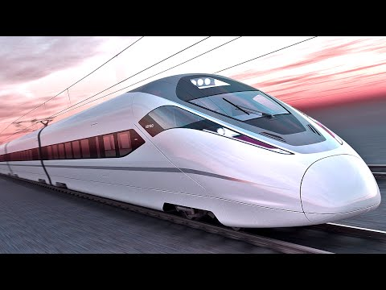
Applied physics
Maglev Train
Submitted by:
Group 6
Hasnain Javed (01-134182-017)
Mubeen Jawad (01-134182-081)
Ruba Mohmand (01-134182-106)
Umair Ilyas (01-134182-108)
Mohammad Bazal (01-134182-112)

Slide 2
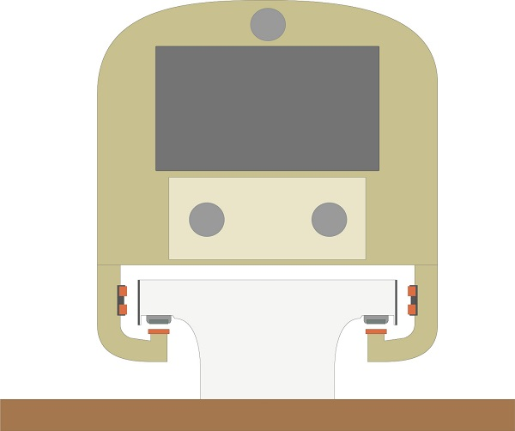
What is meant by Maglev? and Maglev Train.
Maglev stands for magnetic levitation.
Levitation: Any object that is floating by means of magnetic power is known as magnetic levitation.
Maglev train: A train that floats above the tracks.
Principle: Magnetic pressure is used to counteract the effects of gravitational force.
This becomes more clearer when you see the figure below.

Slide 3
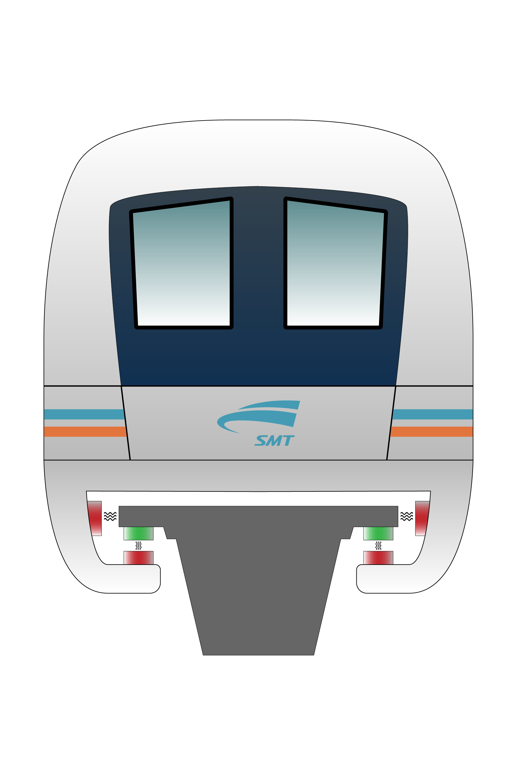
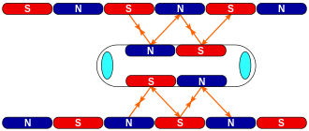
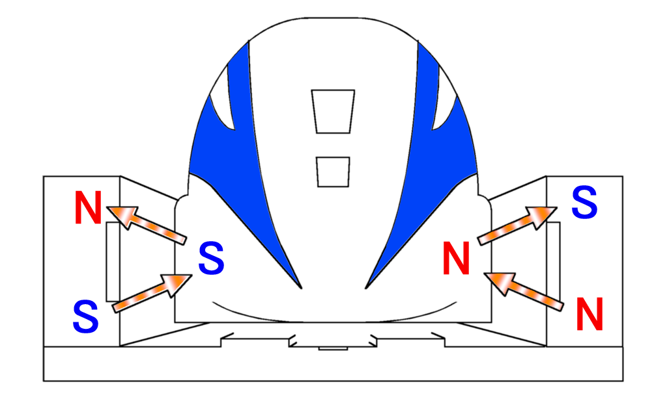
Basic principles of maglev trains
Maglev trains work on the following three principles to reach high speeds
Levitation 2.Propulsion 3.Lateral guidance
Levitation: Magnets on the top of the guide way are oriented to repel similar poles in the magnet under the maglev train. This pushes the train upward into an hovering position.
Propulsion: An alternating current is ran through electromagnetic coils on the guide way which creates a magnetic field that attracts and repels the superconducting magnets on the train and propels the train in forward direction.
Lateral guidance: The super conducting magnet on the train induces a repulsive force from the levitation coils on the side closer to the train and an attractive force from the coils on the farther side. This keeps the train in center.

Slide 4
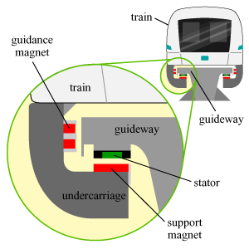
Types of maglev trains
Maglev trains work on two major technologies:
Electromagnetic suspension(EMS)
Electrodynamic suspension(EDS)
Electromagnetic suspension(EMS)
Electromagnets are attached to the train.
Guidance magnets on the sides.
Max speed is around 438km/hr.

Slide 5
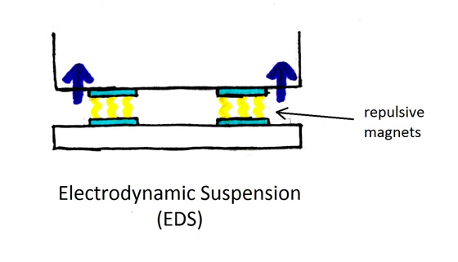
Electrodynamic suspension(EDS)
Supercooled conducting magnets under the train which allow the train to levitate about 10 cm above the tracks.
The force in the tracks created by induced magnetic field in wires or conducting strips in the tracks.
Naturally stable. Requires no feedback control.
Requires retractable wheels at low speeds, max speeds-522km/hr.
by Unknown Author is licensed under

Slide 6
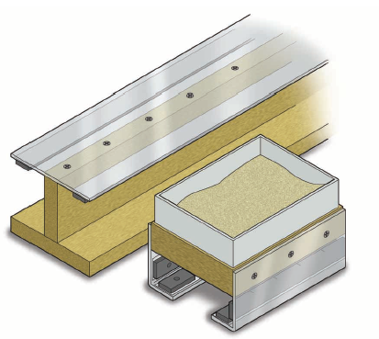
Model of Maglev Train
Materials Needed :
Wooden Planks
Card board
Screws
Long Magnets
Double Sided Tape
Small Plastic container
Sand

Slide 7
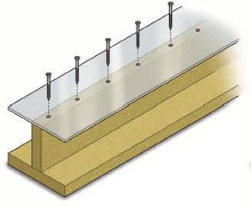
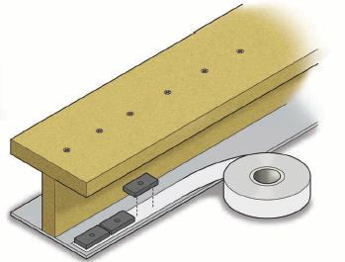
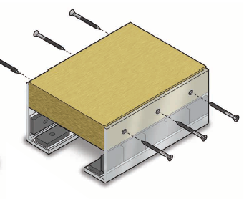
Procedure:
Join the wooden planks perpendicularly with screws and screw the card board on the other side as shown in fig 1.1.
Use Double sided tape to attach the magnetics to the cardboard segment as seen in fig 1.2
Now use some more cardboard, magnetics and small block of wood to create the train as shown in fig 1.3.
Put the train on the track and check if anything needs to be modified.
Fig 1.1
Fig 1.2
Fig 1.3

Slide 8
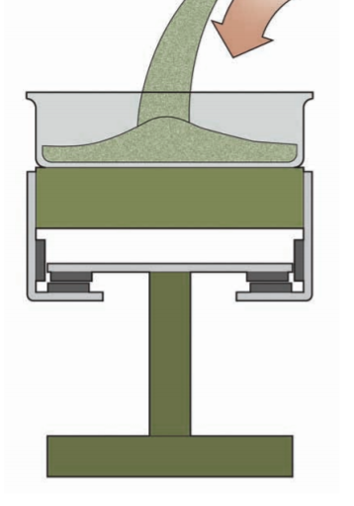
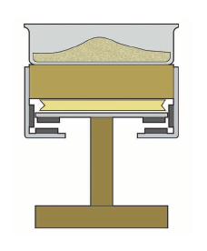
The train might jump up and stick to the magnets of the tracks but it can be fixed by adding some weight onto it.
Add some weight into the plastic container like sand so the train levitates.
Keep adding and removing the sand from the container until the train is balanced.
Fig 1.4
Fig 1.5

Slide 9
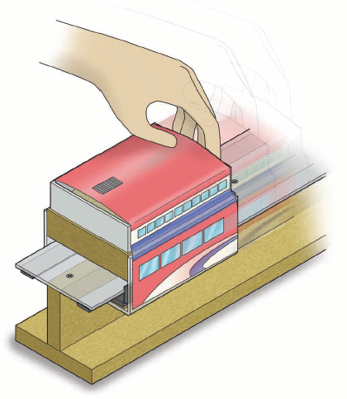
Final Representation
The final representation of the train will look like the figure shown above.

Slide 10
Why use Maglev Trains
They consume less energy.
The require no engine.
They move faster than normal trains because there is no ground friction, the only resistance it faces is air resistance.
There is no wear and tear of the tracks because it has no tires and there is no contact between tires and the tracks.
Maintenance cost is very low as compare to normal tracks.
Maglev trains are not affected by weather and are able to operate even in snow.
Maglev trains can carry more weight and travel at high speeds.

Slide 11
Thank you
This Photo by Unknown Author is licensed under CC BY

